Slide 1
Digital Image processing 8
Dep. of Computer Science & Information Engineering, Asia University
Associate Professor
Rung-Sheng Chen

Slide 2
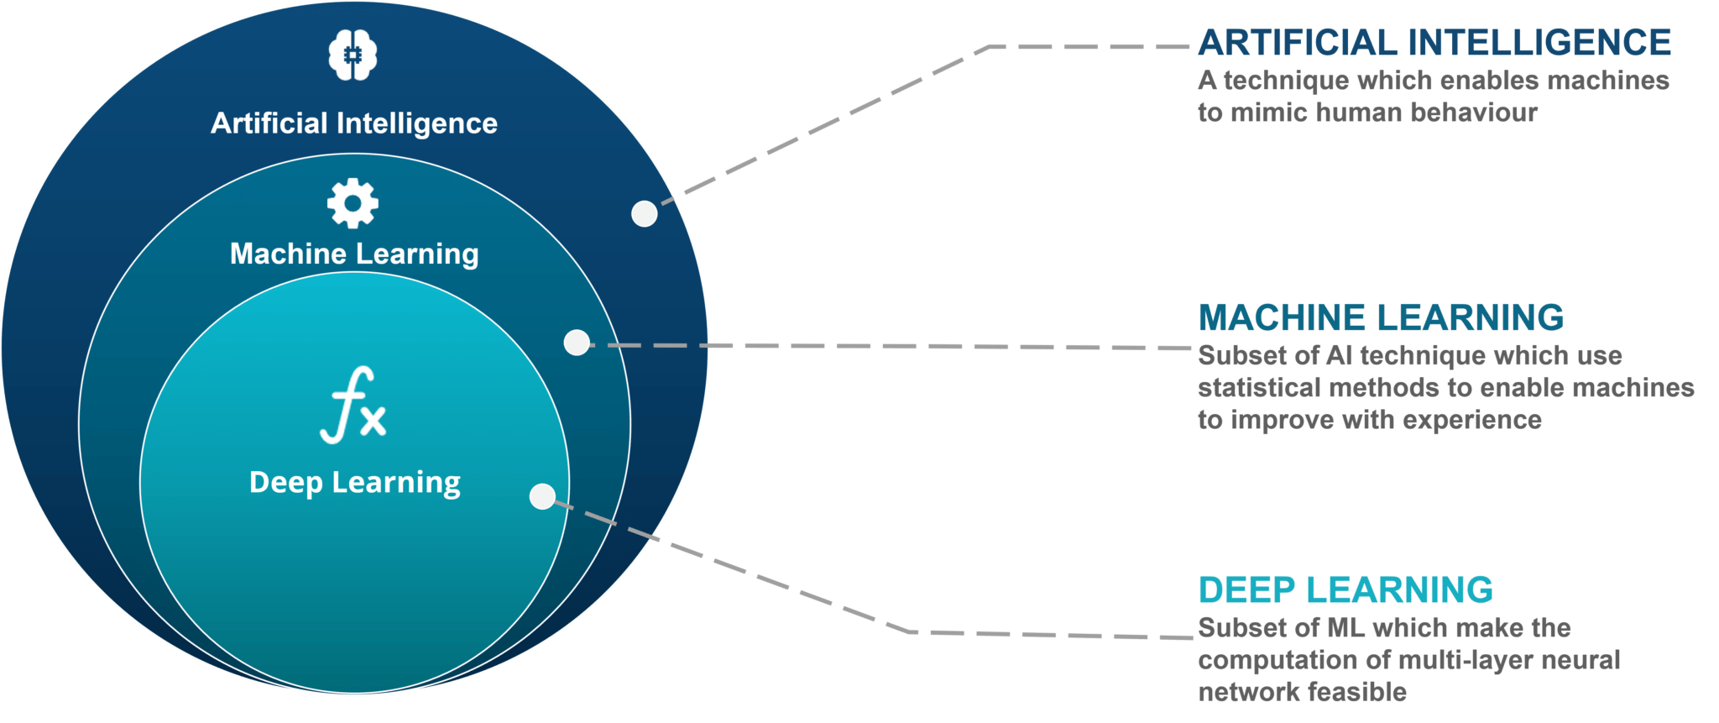
AI: Artificial Intelligence
ML: Machine Learning
DL: Deep Learning

Slide 3
Artificial intelligence was born in the 1950s, when a handful of pioneers from the nascent field of computer science started asking whether computers could be made to “think”—a question whose ramifications we’re still exploring today. A concise definition of the field would be as follows: the effort to automate intellectual tasks normally performed by humans.[1]

Slide 4
As you may can see, that human-level artificial intelligence could be achieved by having
programmers handcraft a sufficiently large set of explicit rules for manipulating knowledge.
This approach is known as symbolic AI, and it was the dominant paradigm in AI from the 1950s to the late 1980s. It reached its peak popularity during the expert
systems boom of the 1980s.

Slide 5
Symbolic artificial intelligence has proven to be suitable for solving well-defined and logical problems, such as chess. However, it is difficult to find and solve more complex and vague problems , such as image classification, speech recognition, and language translation.
Then, a new method has emerged to replace symbolic AI: machine learning.

Slide 6
Tracked back to Victorian England, Lady Ada Lovelace was a friend and collaborator of Charles Babbage, the inventor of the Analytical Engine which was the first-known general-purpose, mechanical computer.
In 1843, Ada Lovelace remarked on the invention, “The Analytical Engine has no pretensions (assumption)whatever to originate anything. It can do whatever we know how to order it to perform.… Its province is to assist us in making available what we’re already acquainted (familiar)with.”

Slide 7
Alan Turing, an AI pioneer, later cited this as "Mrs Lovelace's Objection" in his landmark 1950 paper, "Computers and Intelligent Computing[2],” which
introduced the Turing test as well as key concepts that would come to shape AI.

Slide 8
Analytical engine
Machine learning arises from this question: could a computer go beyond “what we know how to order it to perform” and learn on its own how to perform a specified task?
Could a computer surprise us? Rather than programmers crafting data-processing rules by hand, could a computer automatically learn these rules by looking at data?
Or you may say machine learning try to solve the question beyond the capability of analytical engine.

Slide 9
Introduction to machine learning
Let's take an example of detecting different shapes such as circles,
squares, and rectangles.
(1)We begin with collecting a lot of images for these shapes in different colors and sizes. We should try to have as much diversity in our data as possible.
(2)Then we pass this data to our program and, using a machine learning
algorithm, it learns what different shapes look like by specifically learning about their characteristic properties such as a circle has no corners, while a square and a rectangle both have four corners, but a square has all its sides of equal length. All of this happens within the algorithm and the developer is not required to learn about these specific properties.
(3)Once the program has learned about these shapes, we can now give an unknown shape as input to the program and it will give as output the
correct name for that shape.

Slide 10
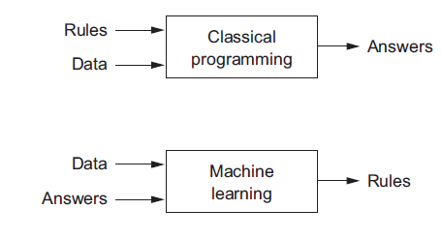
This question opens the door to a new programming paradigm.
In classical programming,
the paradigm of symbolic AI, humans input rules (a program) and data to be processed according to these rules, and out come answers .
With machine learning, humans input data as well as the answers expected from the data, and out come the rules. These rules can then be applied to new data to produce original answers. These are very much like what we did at the face detection, and number recognition projects.
From ref. [1]

Slide 11
A machine-learning system is trained rather than explicitly (clearly)programmed. It’s presented with many examples relevant to a task, and it finds statistical structure in these examples that eventually allows the system to come up with rules for automating the task.

Slide 12
Machine learning is tightly related to mathematical statistics, but it differs from statistics in several important ways.
Unlike statistics, machine learning tends to deal with large, complex datasets (such as a dataset of millions of images, each consisting of tens of thousands of pixels) for
which classical statistical analysis such as Bayesian analysis would be impractical.
As a result, machine learning, and especially deep learning, exhibits comparatively little mathematical theory—maybe too little—and is engineering oriented. It’s a hands-on
discipline in which ideas are proven empirically more often than theoretically.

Slide 13
Deep learning
The essence of deep learning is neutral network.

Slide 14
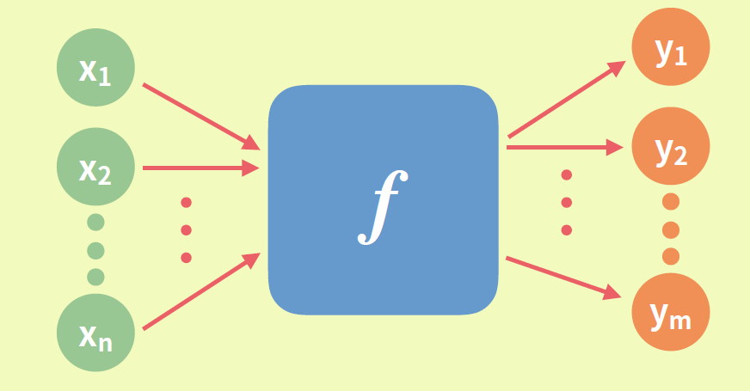
What we learn is a function.

Slide 15
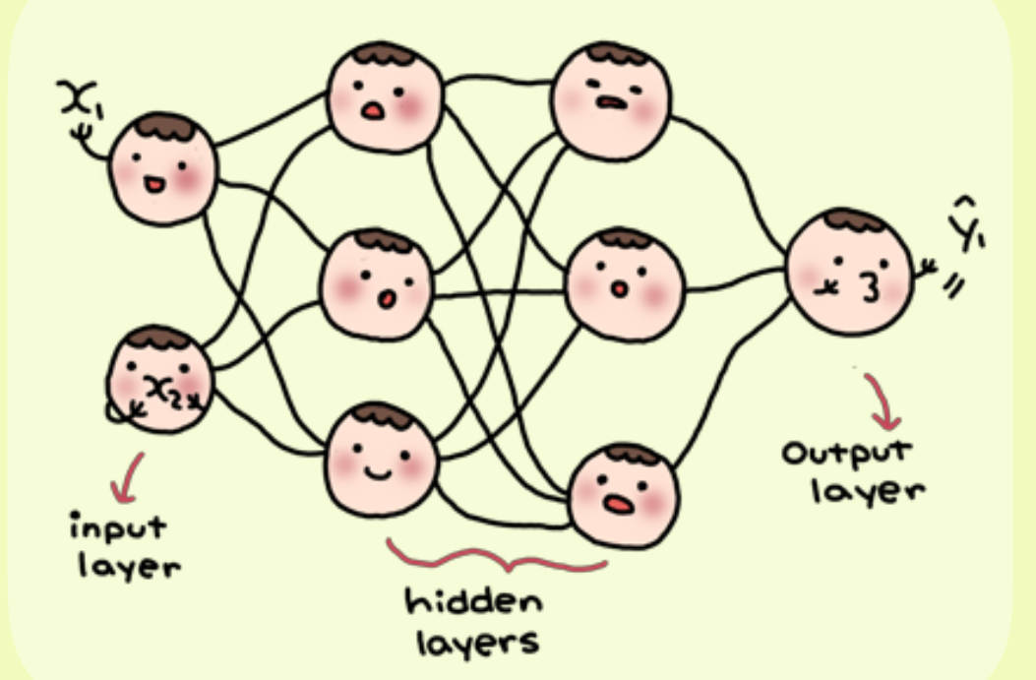
Neutral network

Slide 16
Number recognition
Ref:
https://rayrrr.blogspot.com/2020/01/python-mnist.html

Slide 17
train_history = model.fit(x=x_Train_norm, y=y_TrainOneHot, validation_split=0.2, epochs=100, batch_size=800, verbose=2)
validation_split：Float between 0 and 1. Fraction of the training data to be used as validation data. The model will set apart this fraction of the training data, will not train on it, and will evaluate the loss and any model metrics on this data at the end of each epoch. The validation data is selected from the last samples in the x and y data provided, before shuffling.
epochs：Number of epochs to train the model. Note that in conjunction with initial_epoch, epochs is to be understood as "final epoch". The model is not trained for a number of iterations given by epochs, but merely until the epoch of index epochs is reached.
batch_size： integer or NULL. Number of samples per gradient update.
If unspecified, batch_size will default to 32.
verbose：Verbosity mode (0 = silent, 1 = progress bar, 2 = one line per epoch).
[3]

Slide 18
References:
1. Francois Chollet , “Deep learning with Python”,
Manning Publications Co., 2018
2. A. M. Turing, “Computing Machinery and Intelligence,” Mind 59, no. 236 (1950): 433-460
3. https://scikit-learn.org/stable/

